Slide 1
Adham Ashraf Saeed
Assignment 2

Slide 2
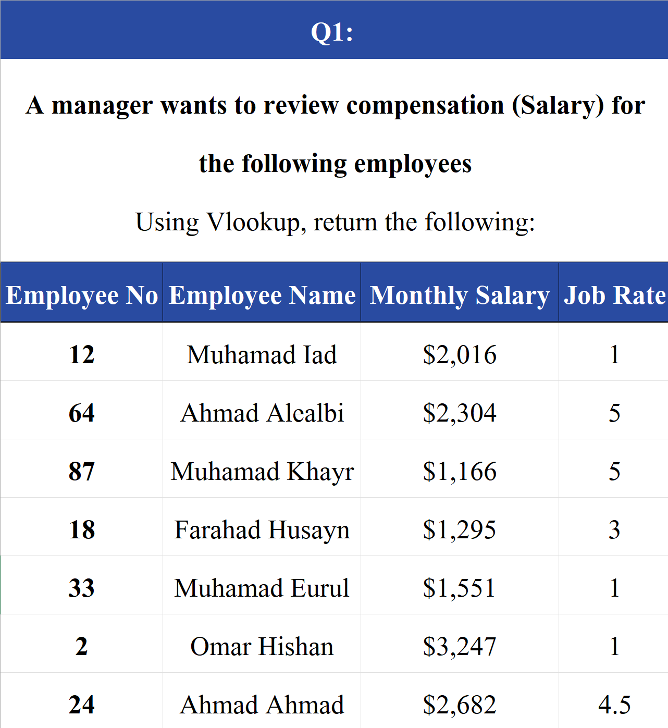
Lookup Functions Question 1
A manager wants to review compensation (Salary) for the following employees
Using Vlookup, return the following:

Slide 3
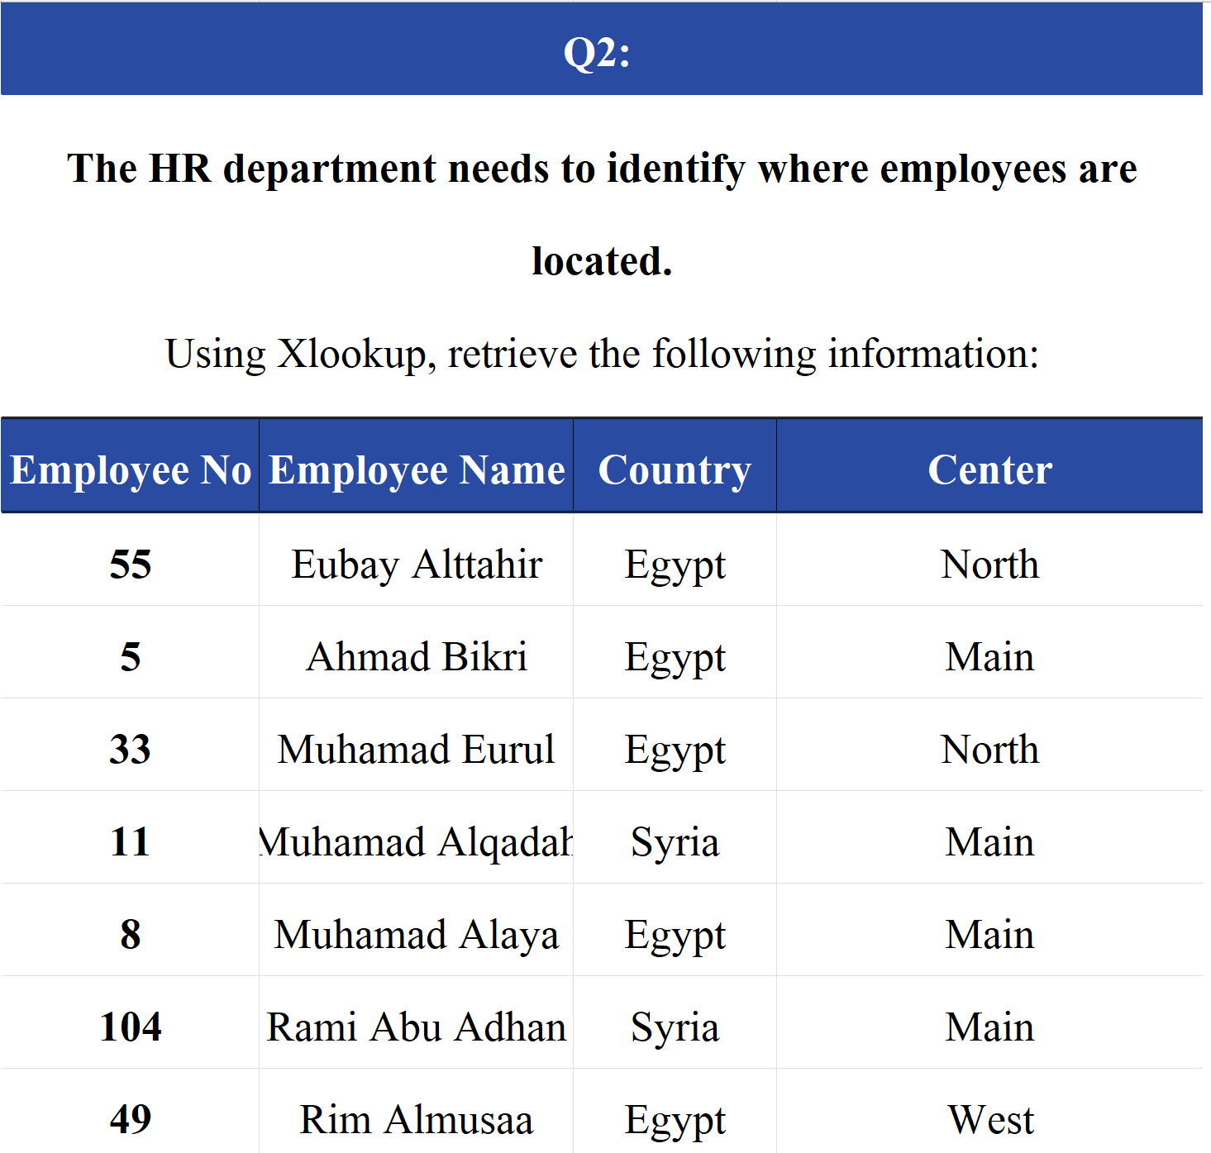
Lookup Functions Question 2
The HR department needs to identify where employees are located.
Using Xlookup, retrieve the following information:

Slide 4
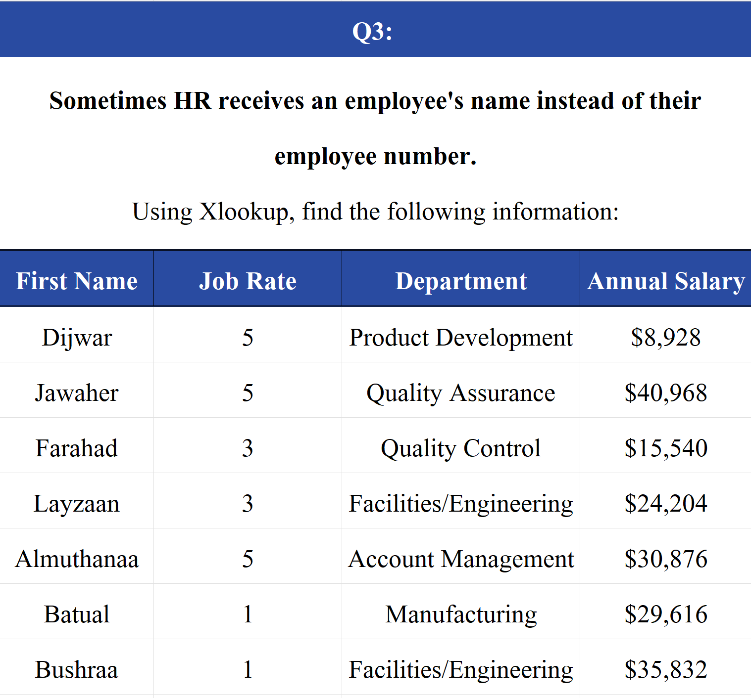
Lookup Functions Question 3
Sometimes HR receives an employee's name instead of their employee number.
Using Xlookup, find the following information:

Slide 5
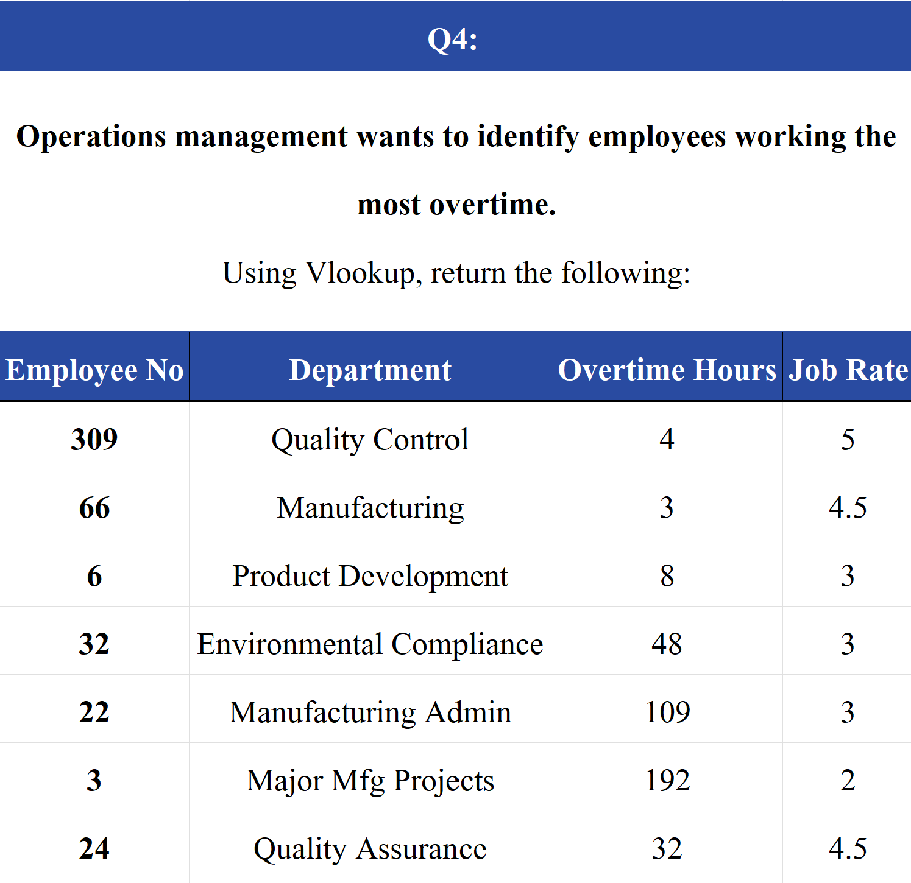

Lookup Functions Question 4
Operations management wants to identify employees working the most overtime.
Using Vlookup, return the following:

Slide 6
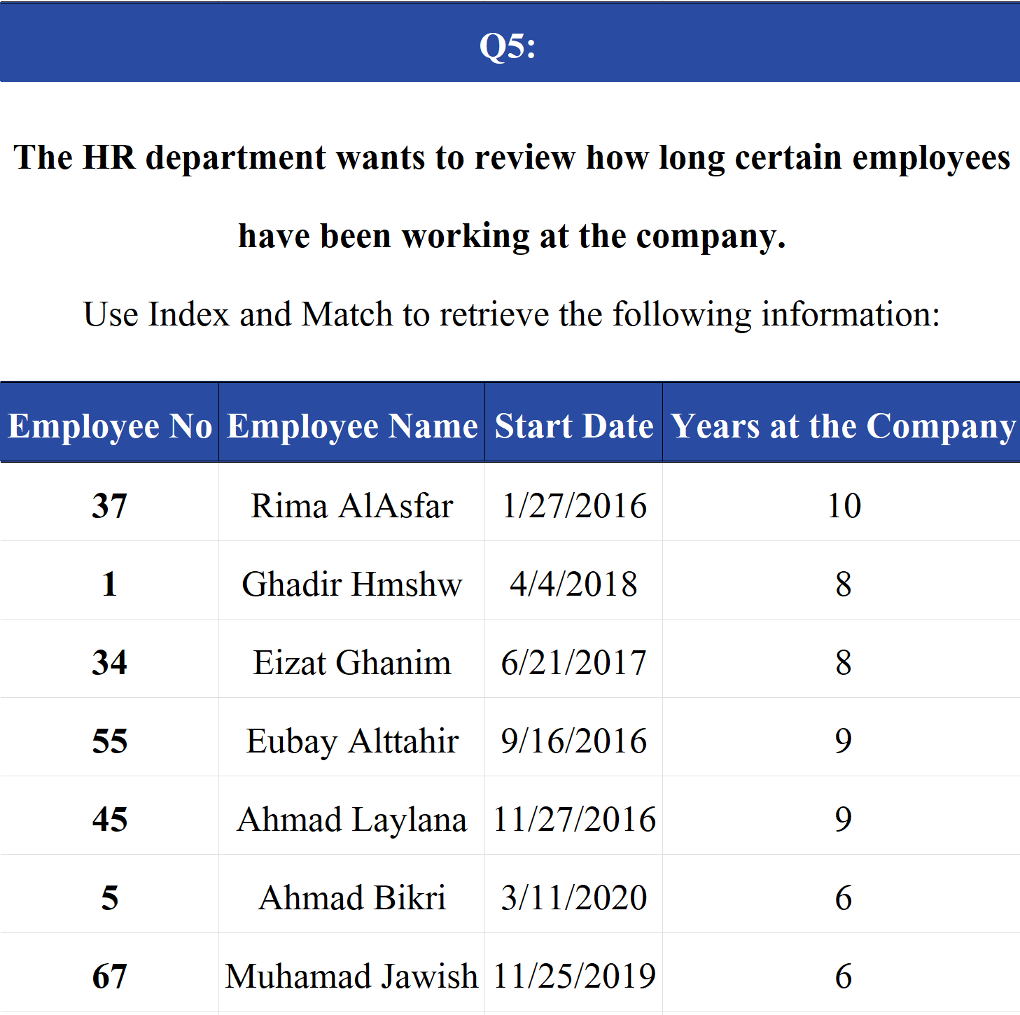
Lookup Functions Question 5
The HR department wants to review how long certain employees have
been working at the company.
Use Index and Match to retrieve the following information:

Slide 7
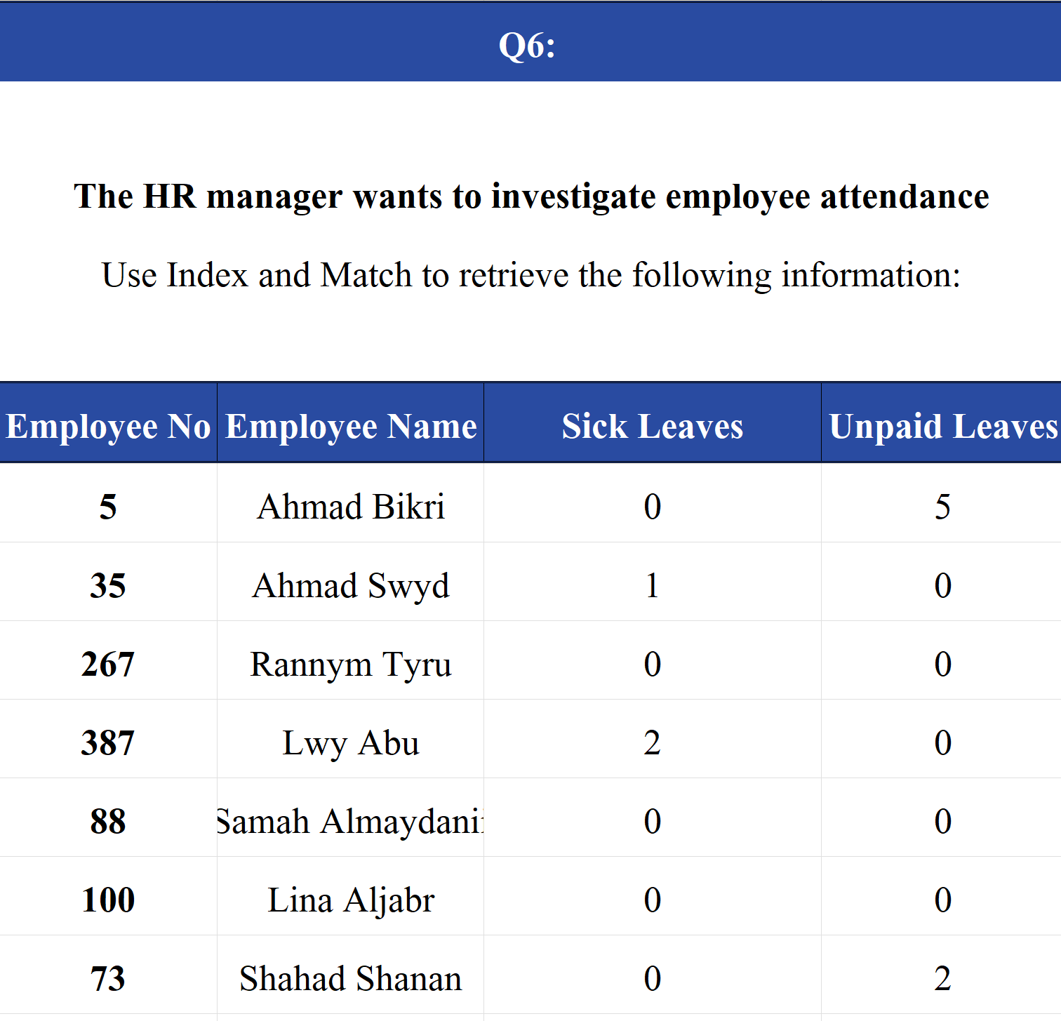
Lookup Functions Question 6
The HR manager wants to investigate employee attendance
Use Index and Match to retrieve the following information:

Slide 8
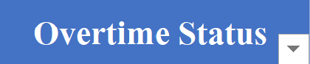
If And Nested If Question 1
HR wants to identify employees who worked significant overtime.
Create a column called Overtime Status.
If Overtime Hours > 100 → "High Overtime"
Otherwise → "Normal"

Slide 9
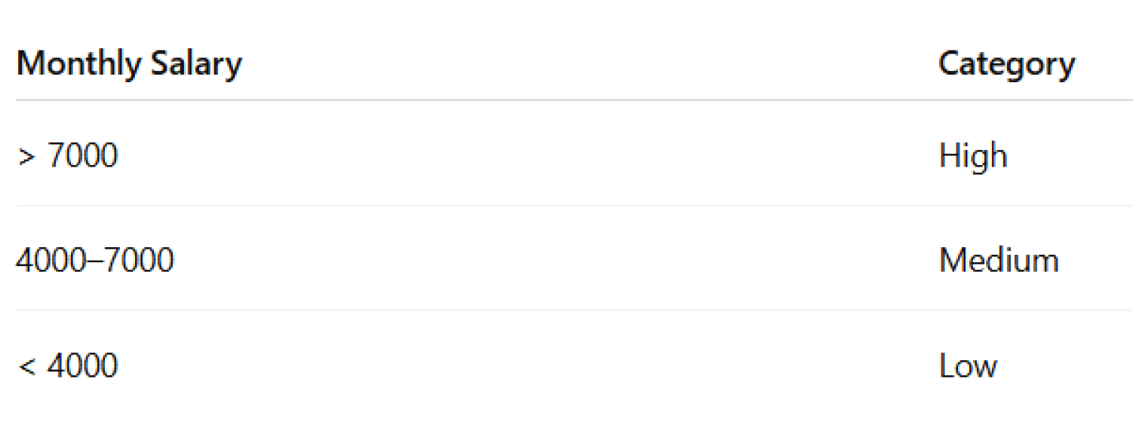
If And Nested If Question 2
Finance wants to classify employees based on Monthly Salary.
Create a column called Salary Category.

Slide 10
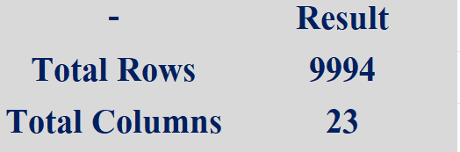

Task 2
Identify:
Total number of records (rows)
Total number of fields (columns)
Insert a new column called Total Sales Value.

Slide 11
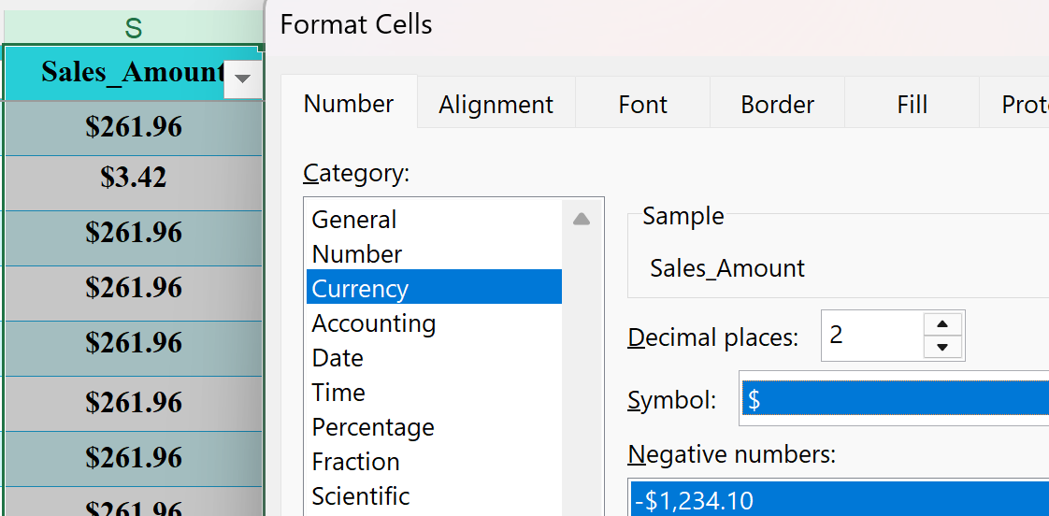
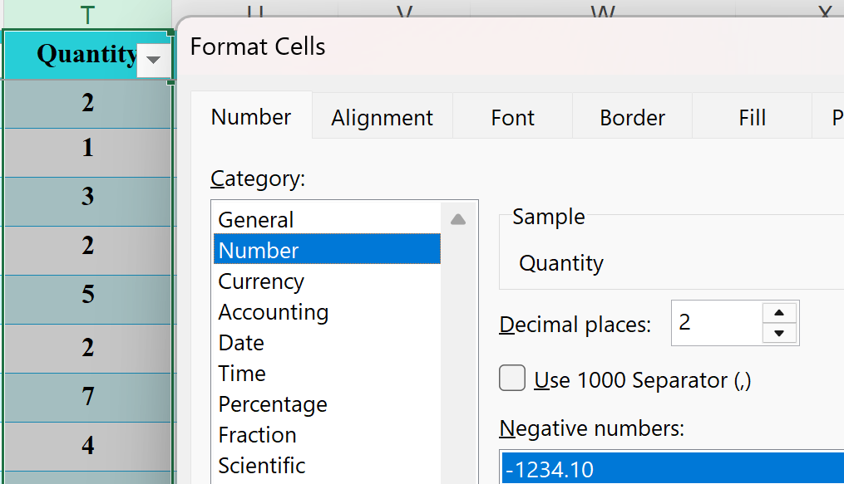
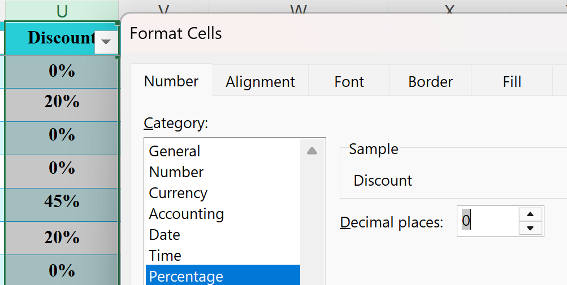
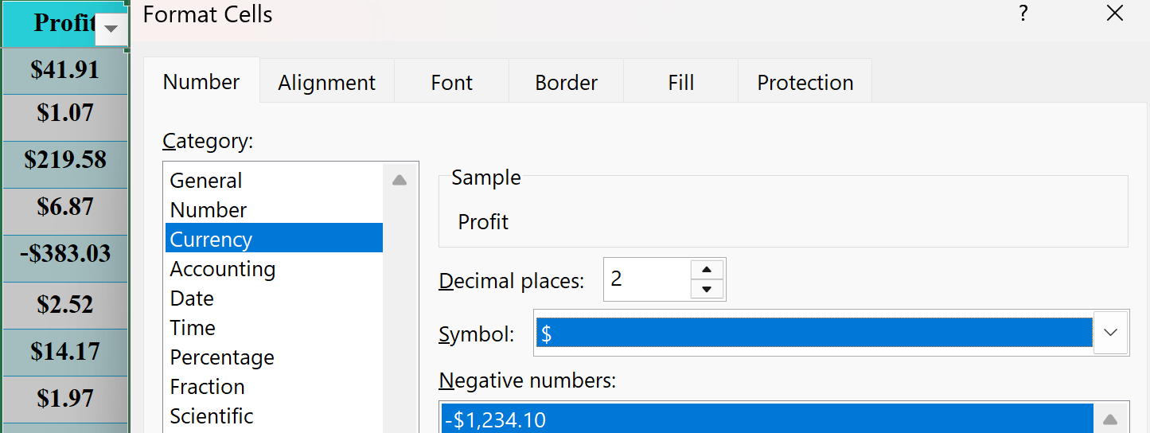
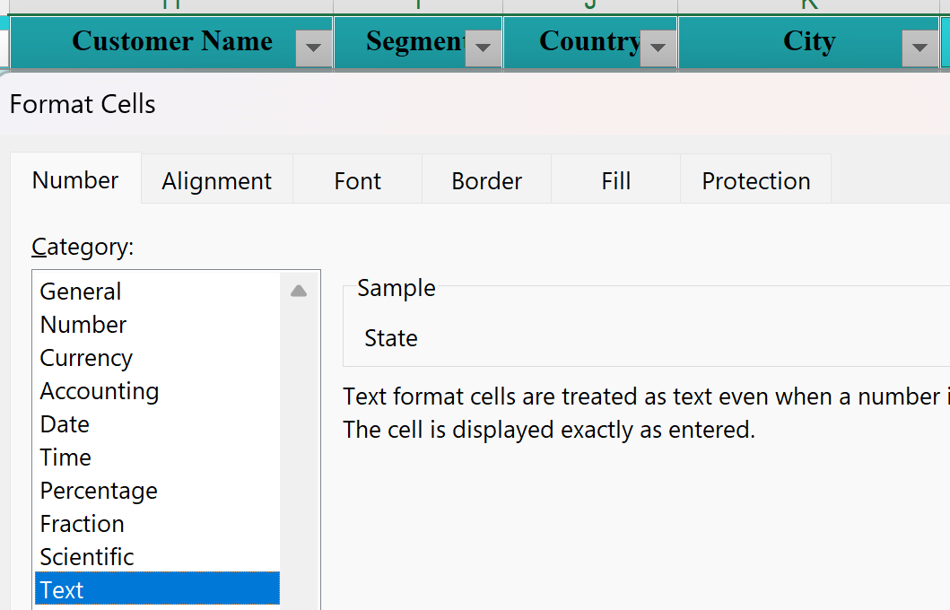
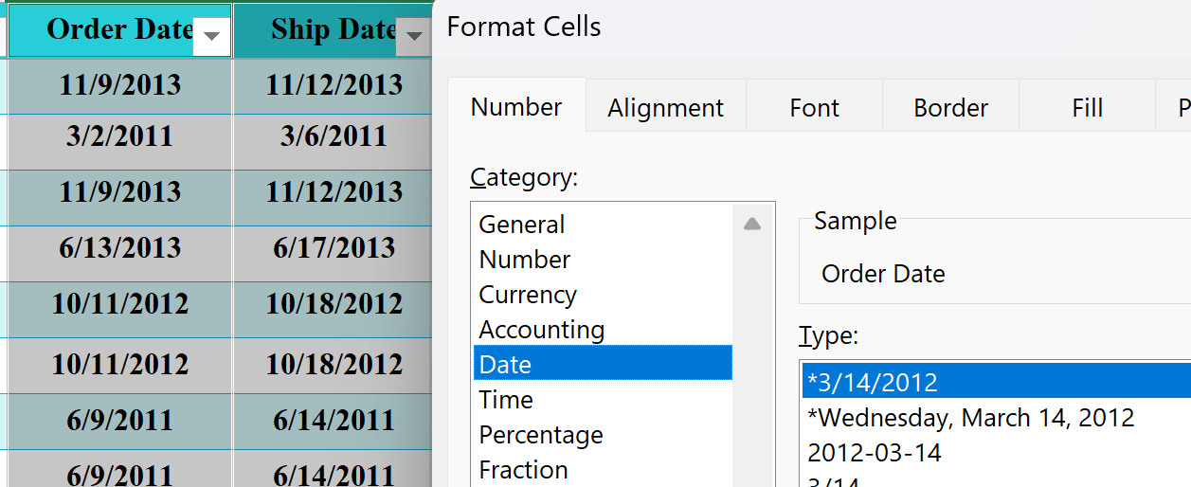
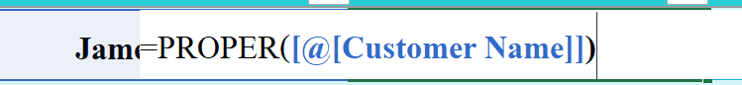
Task 3
Ensure:
Sales, Quantity, and Price columns are numeric.
Date columns are in proper date format.
Apply appropriate number formatting:
Currency for monetary values.
Standardize text formatting (Proper Case).

Slide 12
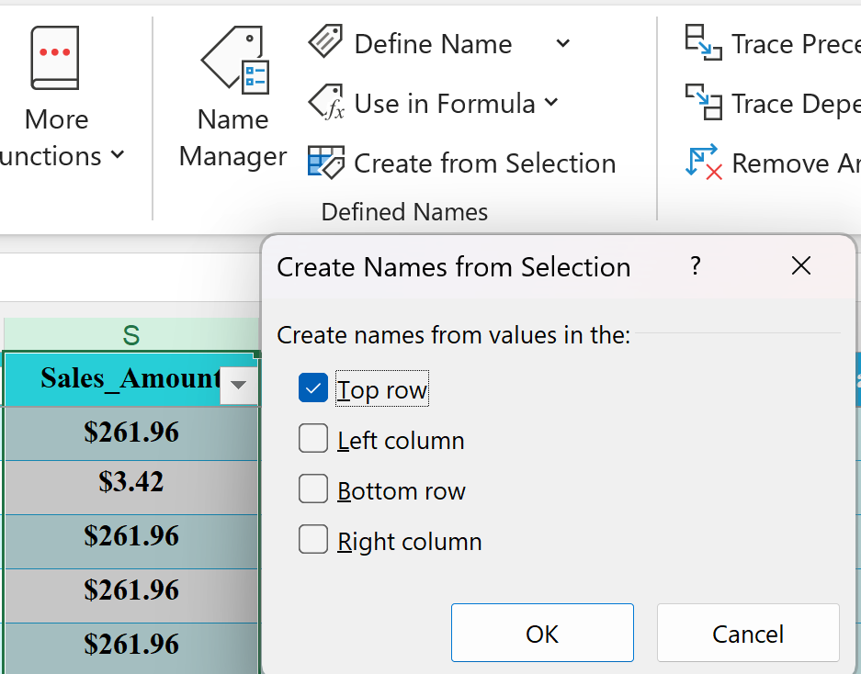


Task 4
Create a named range for:
Sales Amount column → Sales_Amount Use the named range in at least one formula.
Briefly explain why named ranges are useful.
Answer:
Named ranges make formulas easier to read and simplify worksheet management.

Slide 13
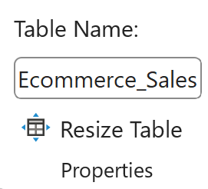
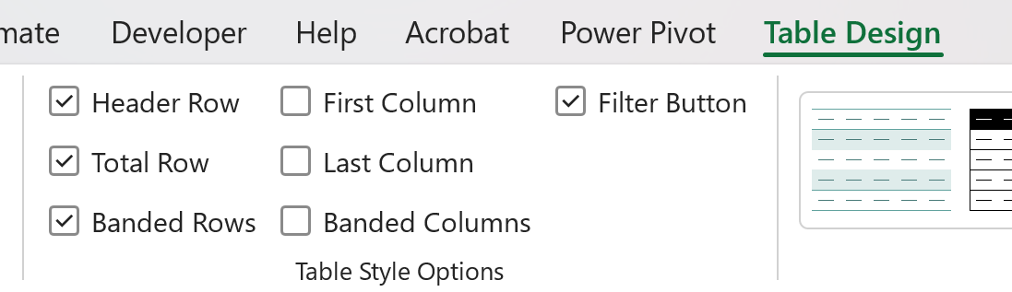
Task 5
Convert the entire dataset into an Excel Table.
Rename the table to Ecommerce_Sales.
Add a Total Row to the table.
Explain the advantage of using a table instead of a normal range.
Answer:
Tables provide easier sorting, filtering, and automatic expansion when new records are added.

Slide 14
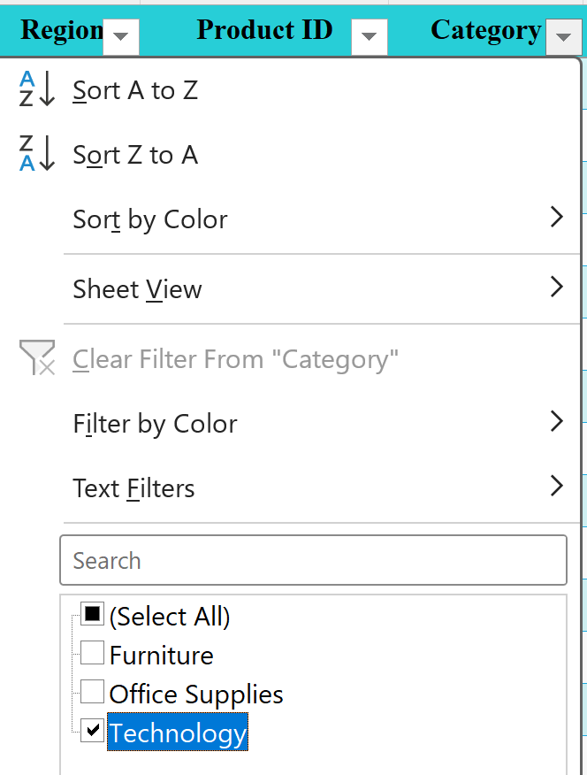
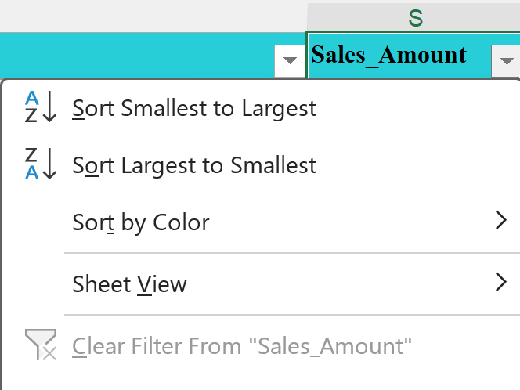
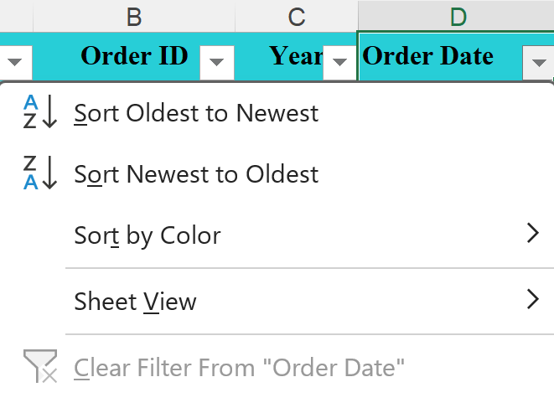
Task 6
Filter the table to show:
One selected product category.
Sort: Sales Amount (Highest → Lowest)
Order Date (Newest → Oldest)

Slide 15
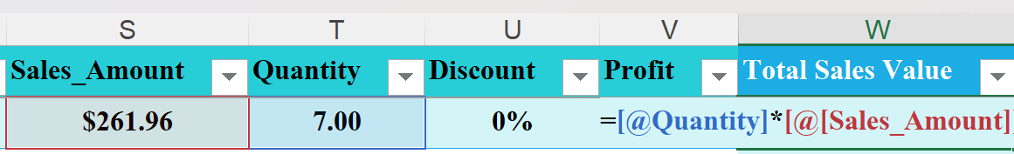
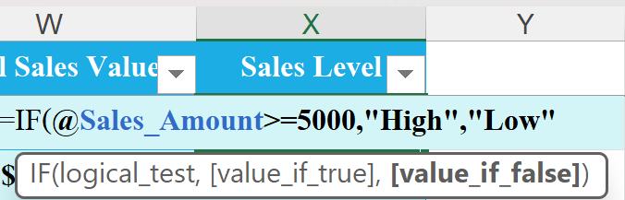
Task 7
Calculate Total Sales Value using:
Quantity × Unit Price
Create a new column Sales Level using:
IF Sales ≥ 5000 → "High"
Else → "Low"

Slide 16
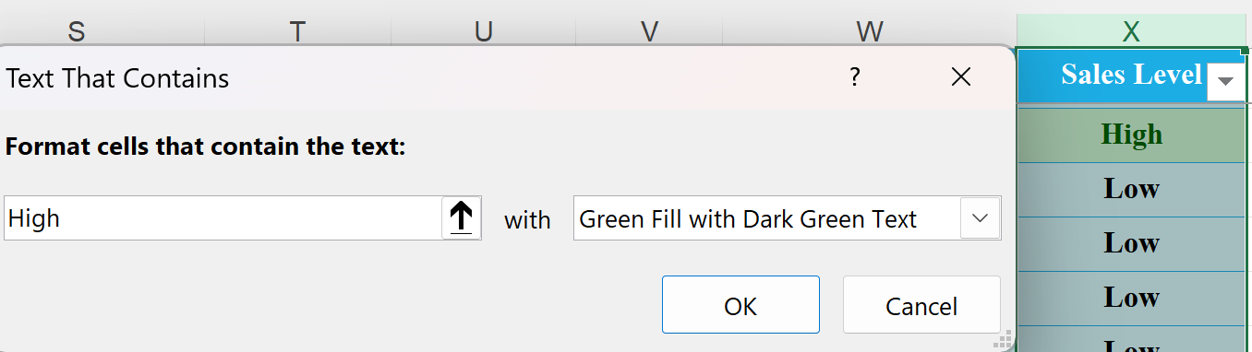
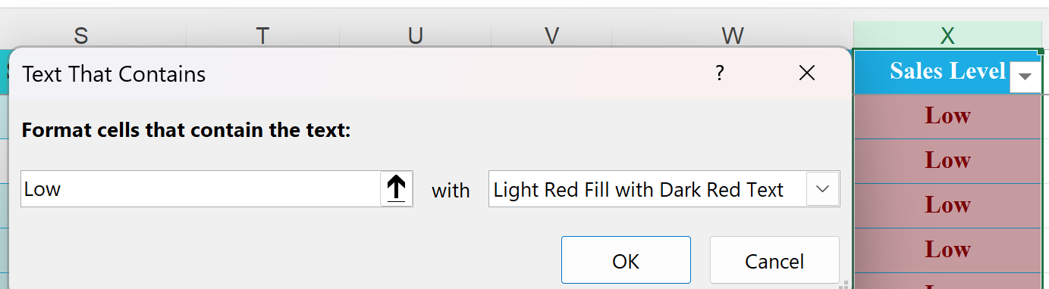
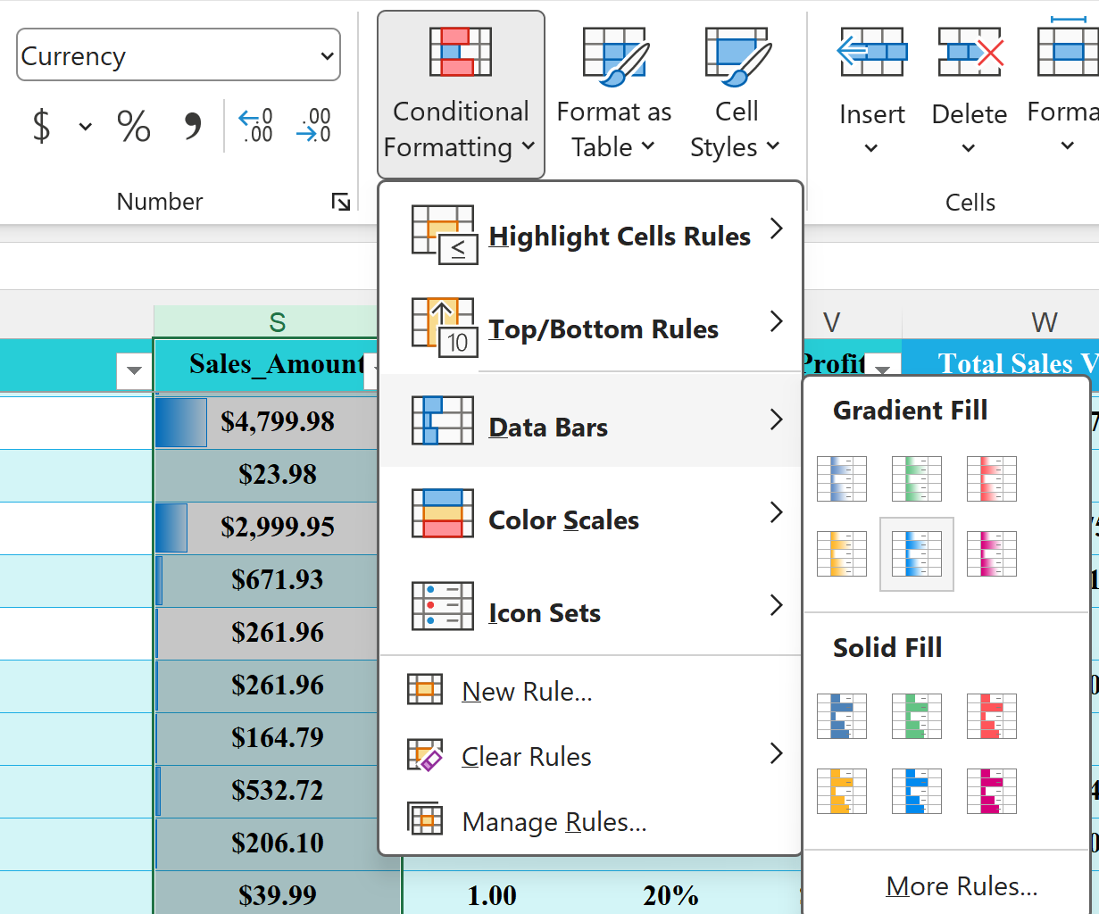
Task 8
Highlight:
High sales values in green.
Low sales values in red.
Apply Data Bars to the Sales column.

Slide 17
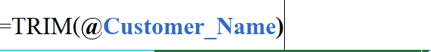
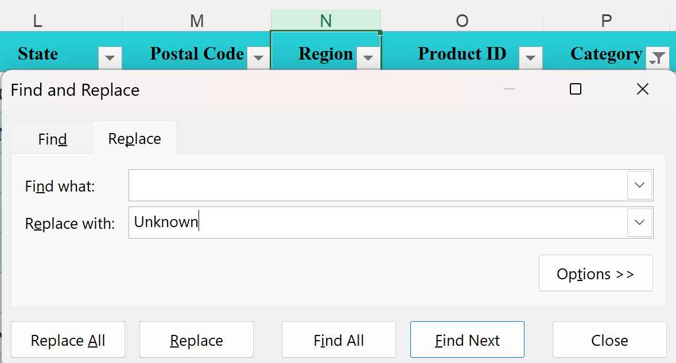
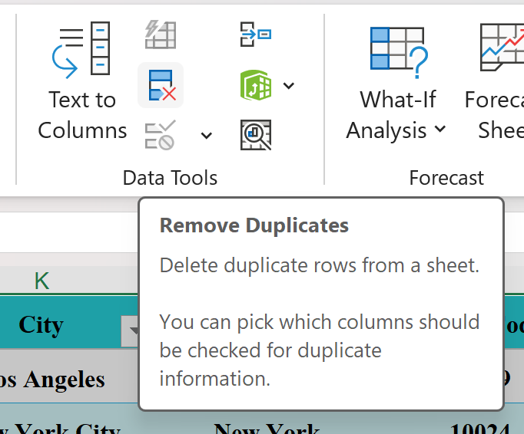
Task 9
Remove extra spaces from text fields.
Replace missing or blank values logically (e.g., Region → “Unknown”).
Remove duplicate records if found.

Slide 18
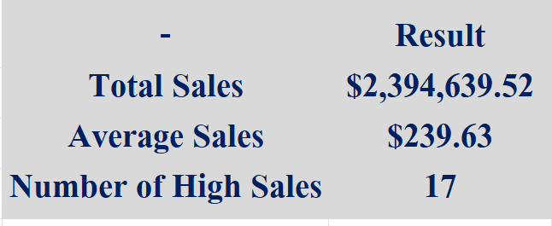
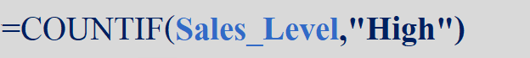
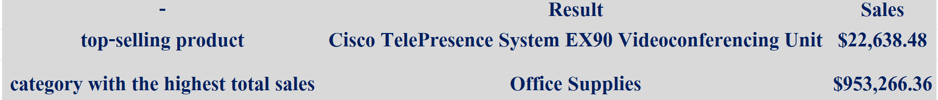
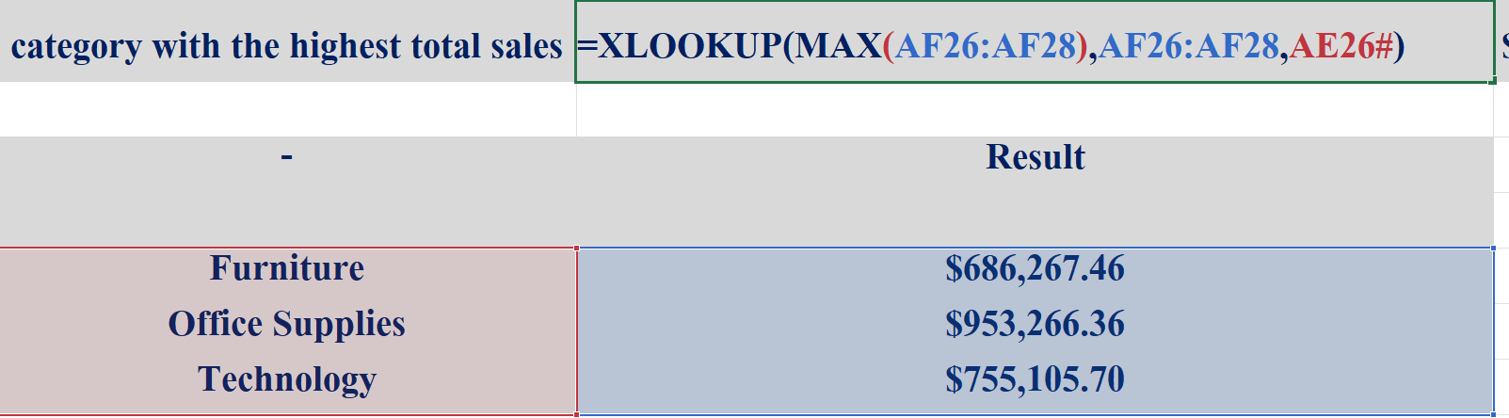
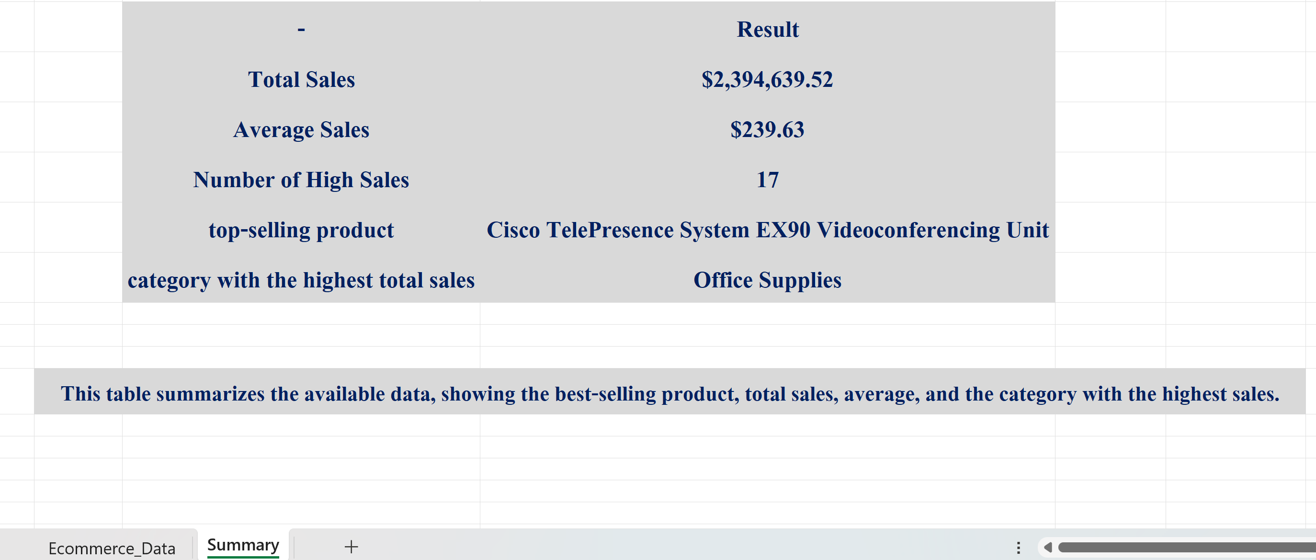
Task 10
Calculate:
Total Sales using SUM
Average Sales
Count: Number of High Sales using COUNTIF
Identify the top-selling product.
Identify the category with the highest total sales.
Add a short insight summary (2–3 sentences) in a new sheet.

